Slide 1


Introduction To List Items
Full-Stack Web Development Bootcamp

Slide 2


What are List Items?
Unordered List
Ordered List
Description Lists
Red
Blue
Green
Yellow
Purple
Alice
Brian
Charlie
David
Emily
List Items
List items in HTML are used to organize content into structured, readable lists, enhancing navigation, readability, and accessibility on web pages.

Slide 3
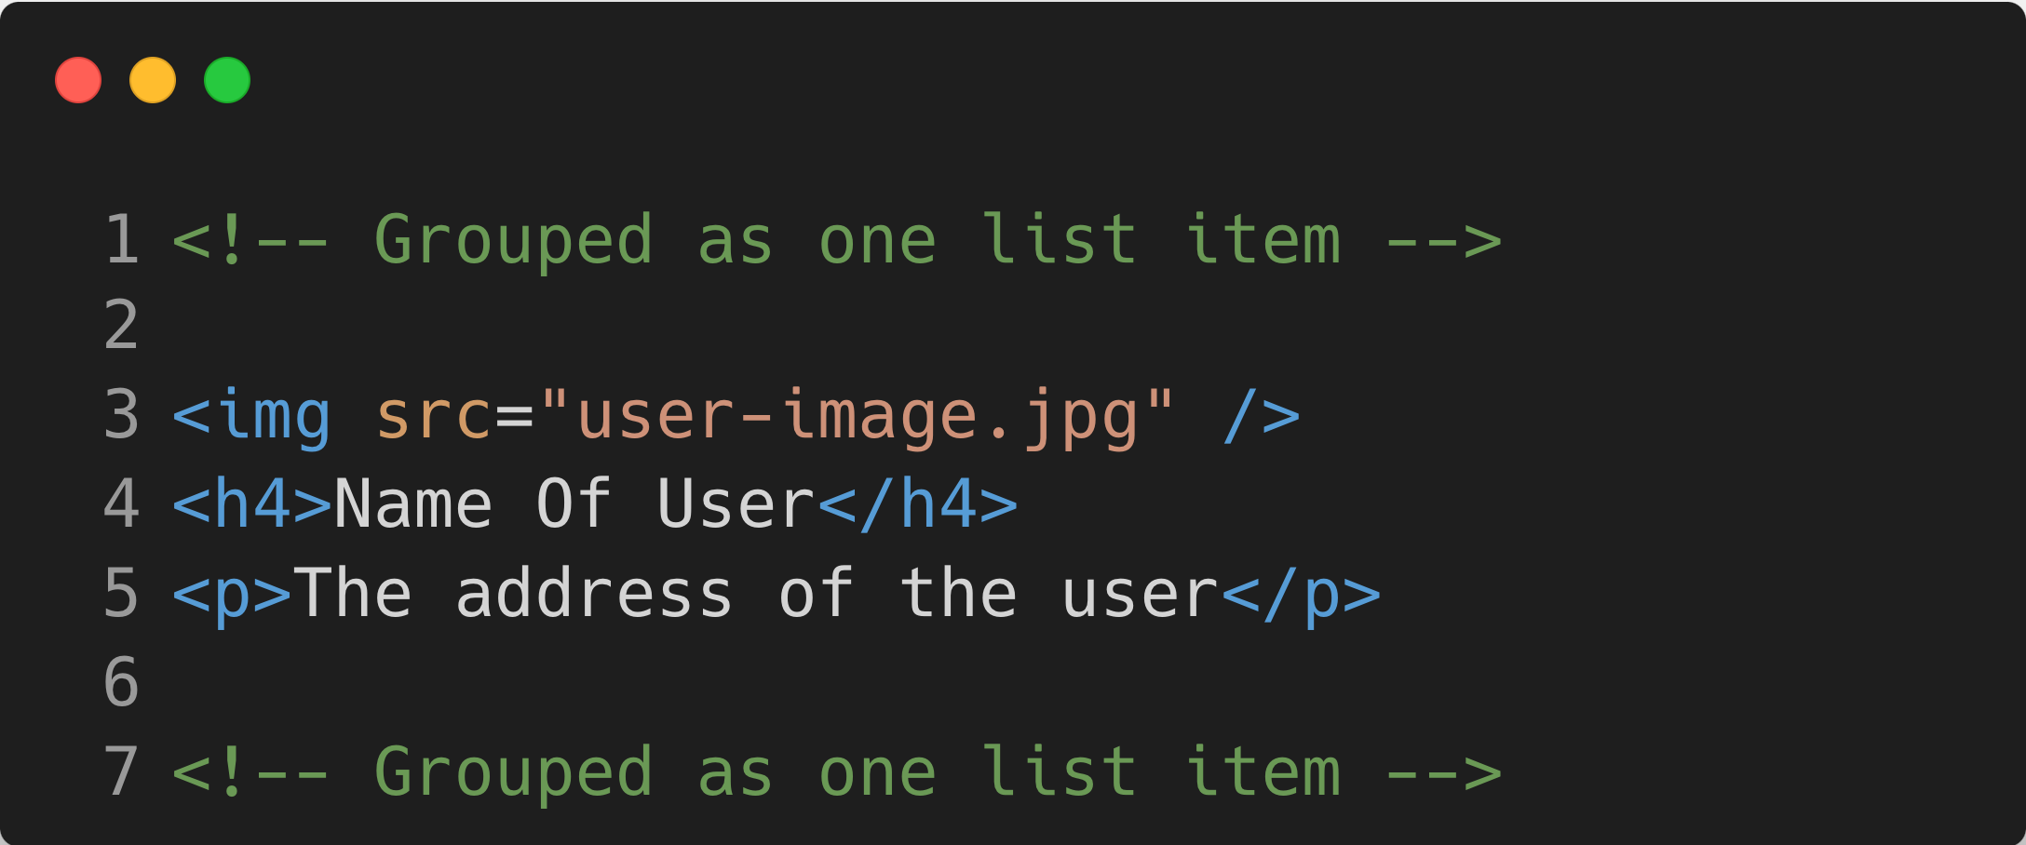
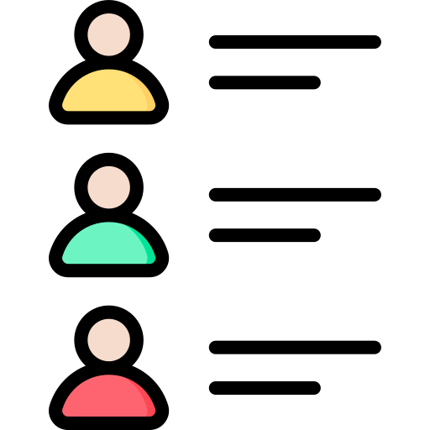
Can Be Complex Collection Of Elements
Unordered List – Sequence Doesn’t matter
List items in HTML aren't limited to single lines of text; they can include complex structures with multiple HTML elements, like images, links, or paragraphs, creating more detailed and informative list entries.

Slide 4

Sequence Important ? Use Ordered List
Ordered List – Sequence Matters
An ordered list in a recipe is necessary to guide the cook through each step in the correct order, ensuring that the preparation process is followed accurately for the best results.

Slide 5
Introducing Description Lists
Coffee
- black hot drink
Milk
- white cold drink
Description Lists
Description lists in HTML are used to pair terms with their corresponding descriptions, providing a clear and structured way to present definitions, explanations, or metadata, improving readability and organization.

